Slide 1

Advanced Programming in C++
STL (Standard Templates Library)
Templates
Functions
Generic Programming

Slide 2
Content
Standard Template Library (STL)
Generic Programming/ Meta-Programming
Preprocessor macros
Function templates
Class templates
STL containers
STL iterators
STL Algorithms

Slide 3
STL
Implement common data structures and algorithms
Implemented using C++ templates
A library of powerful, reusable, adaptable, generic classes and functions
The assortment of commonly used containers
Consistent, fast
Extensible
Known time and size complexity

Slide 4
STL
Containers
Collections of objects or primitive types
Array, Vector, Deque, Set, Map, …
Algorithms
Functions for processing sequenced of elements from containers
find, max, count, accumulate, sort, …
Iterators
Generate the sequences of element from containers
forward, reverse, by value, by reference, constant, …

Slide 5
STL container types
Sequence containers
Array, vector, list, forward_list, deque (keep the order of the inserted elements)
Associative containers
Set, multi set, map, multi map (insert elements in the predefined order or in no order)
Container adapters
Stack, queue, priority queue

Slide 6
Types of Iterators
Input iterators – from the container to the program
Output iterators – from the program to the container
Forward iterators – navigate one item at a time in one direction
Bi-directional iterators – navigate one item at a time both directions
Random access iterators – directly access container item

Slide 7
Types of Algorithms
About 60 algorithms
Non-modifying
Modifying

Slide 8
Generic Programming with Macros
Generic Programming – writing the code that words with a variety of types as arguments, as long as those argument types meet specific syntactic and semantic requirements (Bjarne Stroustrup)
If the code is generic, it means it can work with any type, if it makes sense
Macros (CAREFULL)
Function templates
Class templates

Slide 9
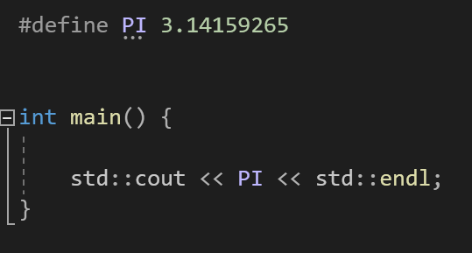
Generic Programming with Macros
Macros (#define)
C++ preprocessor directives
No type information
Simple Substitution

Slide 10
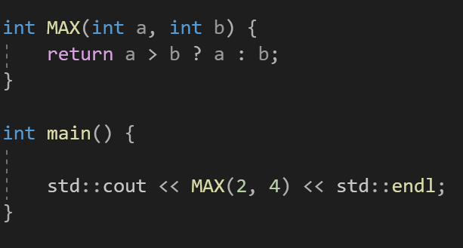
Generic Programming with Macros
For example:
Function that finds maximum of two integers
Works with integers only
Shows 4

Slide 11
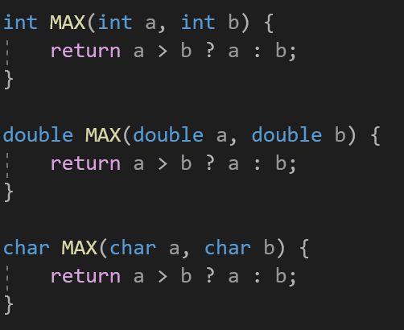
Generic Programming with Macros
To make it work for all types – function overloading

Slide 12
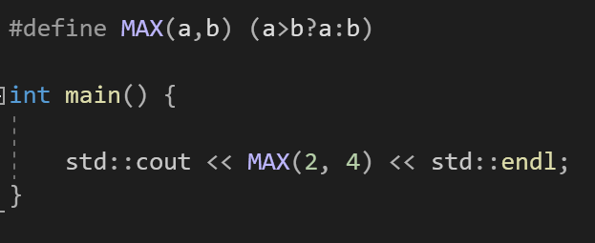
Generic Programming with Macros
Generic approach – one function that takes any parameter
One way is to use macros with the parameters
When preprocessor identifies MAX with two arguments it replaces it with the expression in #define

Slide 13
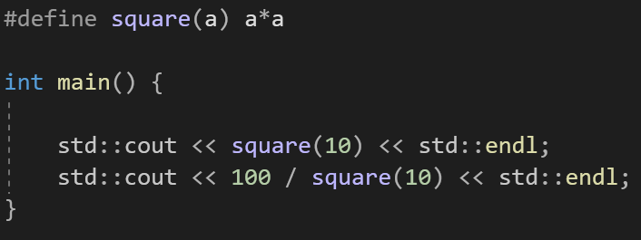
Generic Programming with Macros
Since it is a simple substitution, be very careful
100/10*10 = 100
Prints 100
Prints 100

Slide 14
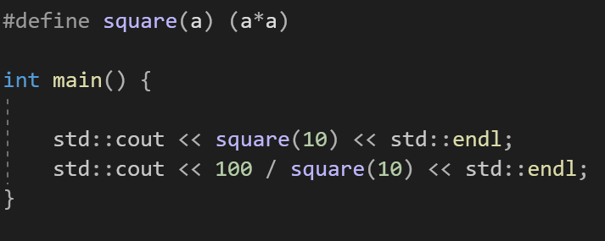
Generic Programming with Macros
Since it is a simple substitution, be very careful
100/(10*10) = 1
Prints 100
Prints 1

Slide 15
Function templates
Better to implement generic functions using function templates
C++ templates
Blueprint to generate generic functions and classes
Allows to plug-in any data type
Compiler generates the appropriate function/class from blueprint
It is completed in compile time
Complicated

Slide 16
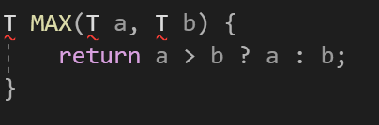
Function templates
The same example of MAX(int a, int b)
We can replace type with T
This will not compile

Slide 17
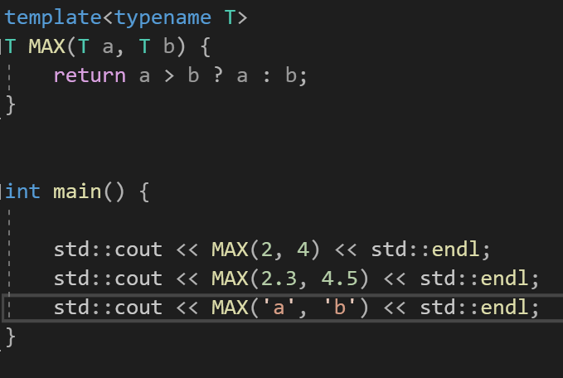
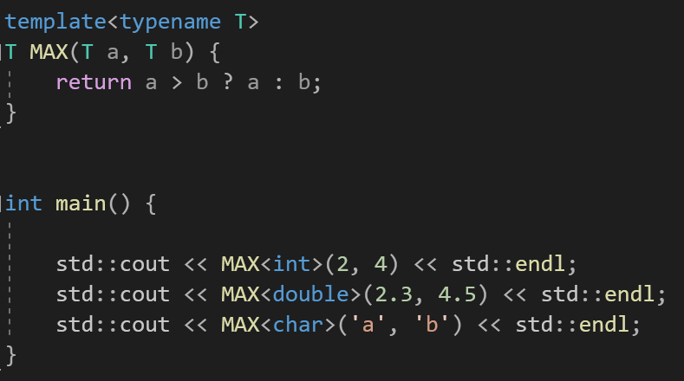
Function templates
The compiler needs to now the template of the function
Provide the parameter (compiler can identify the type)
The specialized function is generated in compile time

Slide 18
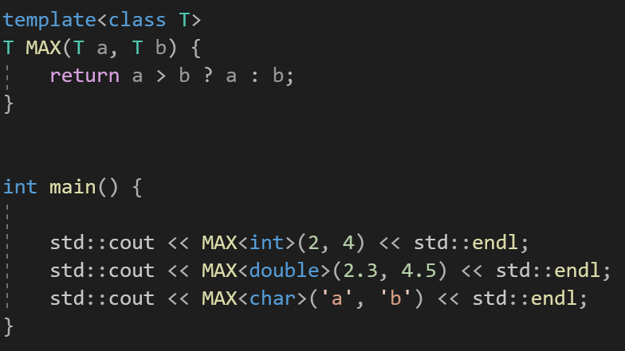
Function templates
The compiler needs to now the template of the function
Provide the parameter
Can use class or typename in (template) it is equivalent

Slide 19
Function templates
Almost any type can be used. The type used in the function must support the operator.
If user defined class is provided, than operator> must be overloaded

Slide 20
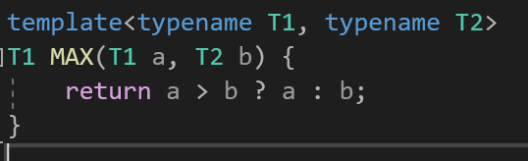
Function templates
The number of templated parameters is not limited and they can be different types

Slide 21
Function templates
The number of templated parameters is not limited and they can be different types

Slide 22
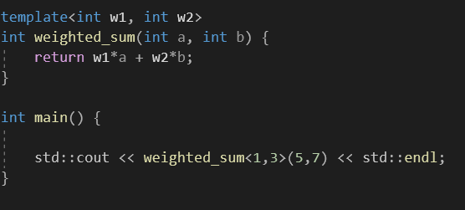
Function templates
Typename or class can contain exact data type and can be used to initialize variables
weighted_sum will return 26

Slide 23
Class template
Similar to function template
Allow plug-in data type
Compiler generates the appropriate class from blueprint
Complex

Slide 24
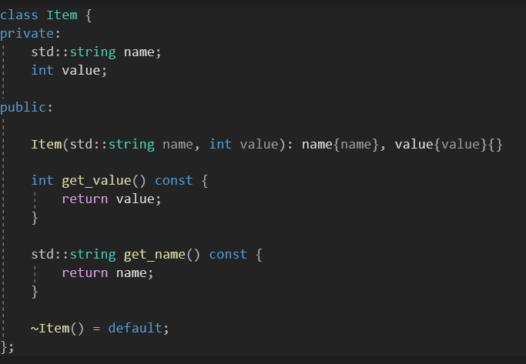
Class template
For example:
Class Item
Attributes of type string and int
How to create a class with different type in name and value

Slide 25
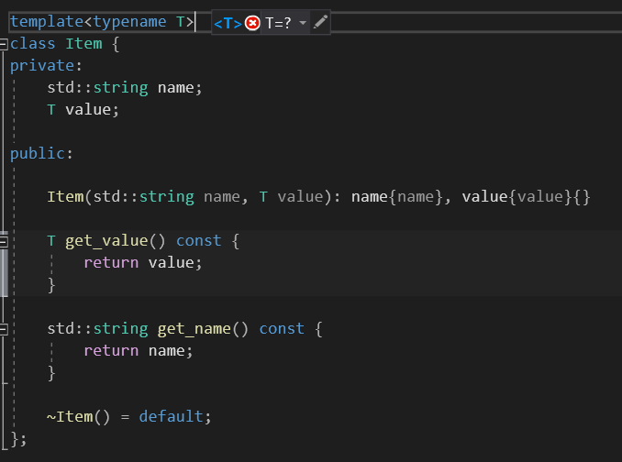
Class template
Item<int> item1{“Name”,3}
Item<double> item2{“Name”, 3.5}

Slide 26
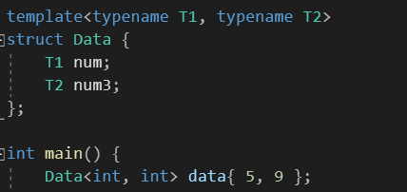
Class template
We can have multiple template parameters in the class templates
The type can be different

Slide 27
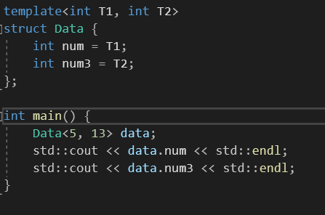
Class template
Typename or class parameter can be changed to the specific type or variable
In this case, parameter T1 must be provided of the type declared in template
Print 5
Print 13

Slide 28
STL containers
Data structures that can store object of almost any type (template-based classes)
Each container has member functions
Some are specific to the container
Others are available to all containers
Each container has associated header file

Slide 29
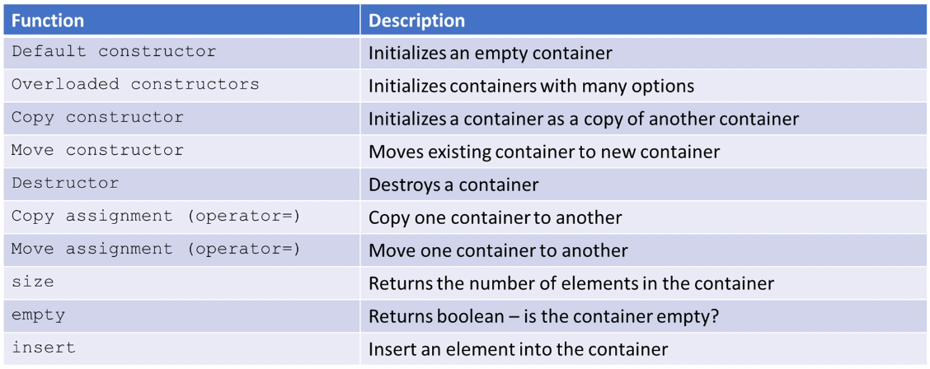
STL containers

Slide 30
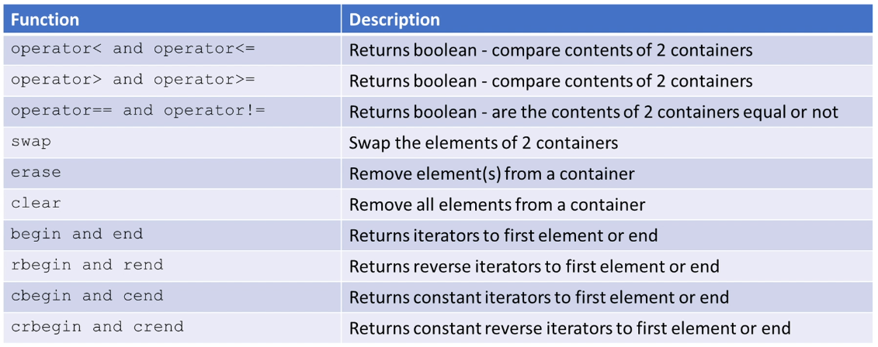
STL containers

Slide 31
STL containers
Container elements. When object is stored in the container the copy is stored
All primitive types
Elements must contain Copy constructor and Copy assignment
Elements must contain Move Constructor and Move assignment
Ordered associative containers must be able to compare elements
operator<, operator== must be overloaded

Slide 32
STL iterators
Allows abstracting an arbitrary container as a sequence of elements
Objects that work like pointers by design
Most container classes can be traversed with iterators

Slide 33
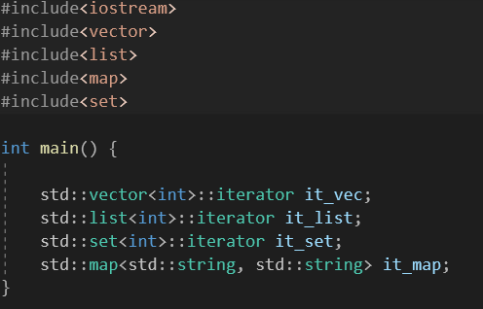
STL iterators
Iterators must be declared based on the container type that they will iterate over
container_type::iterator_type name;

Slide 34
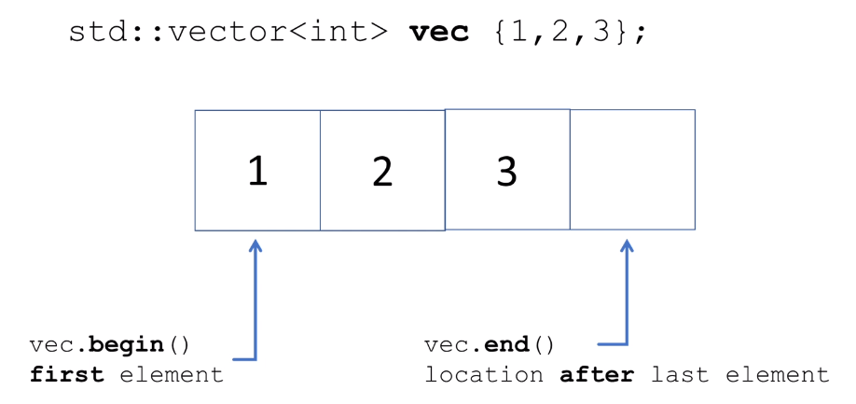
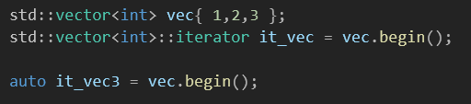
STL iterators
Example:

Slide 35
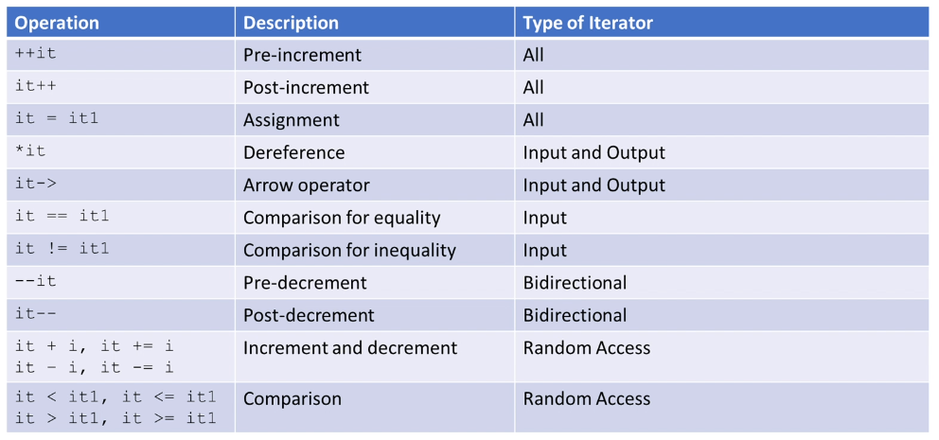
STL iterators

Slide 36
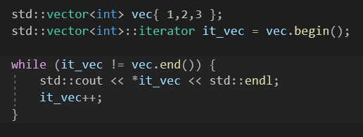
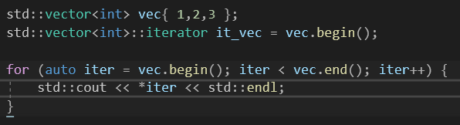
STL iterators
Application of iterators
Prints 1 2 3
For containers that does not allow to access randomly iterators are necessary

Slide 37
STL iterators
Types of iterators:
iterator
begin() and end()
const_iterator (do not allow to change the content of the container)
cbegin() and cend()
reverse_iterator
rbegin() and rend()
const_reverse_iterator (do not allow to change the content of the container)
crbegin() and crend()

Slide 38
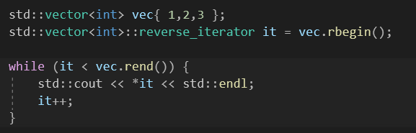
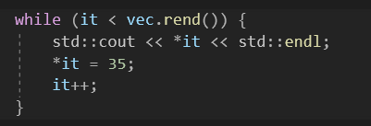
STL iterators
Prints 3 2 1
Iterators can be used to change the content of container
Sets all elements to 35

Slide 39
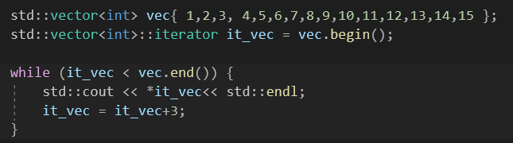

STL iterators
Prints every third element

Slide 40
STL Algorithms
STL algorithms word on sequences of container elements provided to them by iterator
Many algorithms require extra information in order to work:
Function objects
Function pointers
Lambda expressions

Slide 41
STL Algorithms
#include<algorithm>
Different container support different type of iterators
All STL algorithms expect iterators as arguments
Determines the sequence obtained from the container
Be aware of iterator invalidation !!!
Iterators point to container elements
it is possible that iterator may become invalid during processing
For example, iterator of vector object. Function clear() is called during iteration as a result behavior is undefined

Slide 42
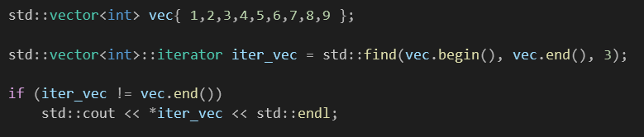
STL Algorithms
Algorithm – std::find()
It tries to locate the first occurrence of the element in the container
Returns iterator that points to the located element or end() if does not find it
Prints 3

Slide 43
STL Algorithms
Algorithm – std::find()
It needs to compare object
It uses operator== (it must be overloaded in user defined classes)

Slide 44

STL Algorithms
Similar functions – std::count(), returns number of times specific element is present in the container
It needs to compare object
It uses operator== (it must be overloaded in user defined classes)
Counts how many times 3 is present in the vector
Prints 5

Slide 45
STL Algorithms
Algorithm – std::for_each()
It applies function to each element in the iterator sequence
Function must be provided to the algorithm:
As a function object
As a function pointer
As a lambda expression

Slide 46
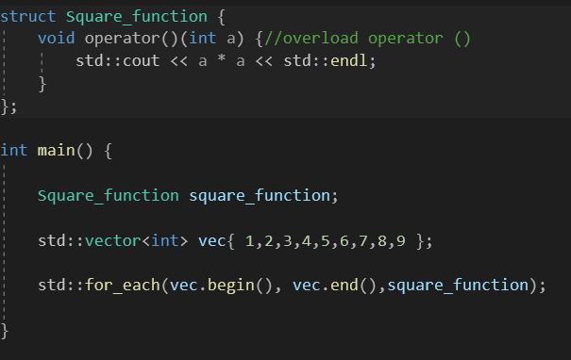
STL Algorithms
Apply std::for_each() using function object (functor)
Prints 1,4,9,16,…
It can be class with single public method
The method that is overloaded is function call operator, it expects single parameter of same type as in container

Slide 47
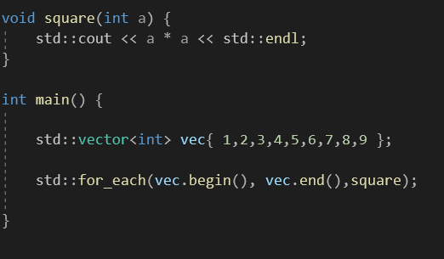
STL Algorithms
Apply std::for_each() using function pointers
Prints 1,4,9,16,…
Name of the function is provided without any parameters

Slide 48

STL Algorithms
Apply std::for_each() using lambda expressions
Prints 1,4,9,16,…
Lambda expression does not have a name ([] is provided), next list of parameters (int a) and the scope of the function {}

Slide 49
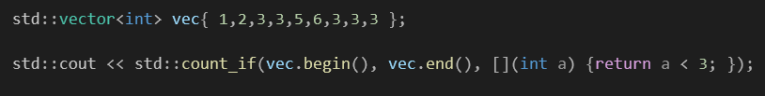
STL Algorithms
Similar functions – std::count_if(), returns number of times specific element is present in the container, if it matches specific condition
It needs to compare object
It uses operator== (it must be overloaded in user defined classes)
If element of the container is smaller than 3 (result of lambda function is true) it counts it
Prints 2

Slide 50
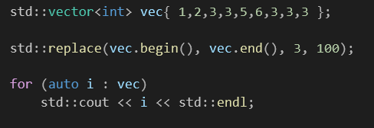
STL Algorithms
Algorithm std::replace – replaces every specific element with some specific value
Uses operator==, for user defined classes need to be overloaded
Changes the elements of the original container
Prints 1 2 100 100 5 6 100 100 100

Slide 51

STL Algorithms
Algorithm std::all_of() – checks if all the elements meet defined condition
Returns true if all elements of the container are smaller than 4, false otherwise
For user defined classes must contain operator used in lambda function

Slide 52
STL Container
Arrays
Fixed size (size must be known)
Direct element access
Provides access to the underlying array
All iterators are available and do not invalidate
#include<array>
std::array<type, size> name{elements}

Slide 53
STL Container
Array methods
arr.size() – size of the array
arr[0] – access 0th element
arr.at(0) – access 0th element (with bounds checking)
arr.front() – 0th element of the array
arr.back() – last element of the array
arr.fill(10) – fills the array with 10
arr.empty() – checks if the array is empty (returns boolean expression)
arr.swap(arr2) – swaps two arrays of the same size and type
int* data = arr.data() – gets the address of the raw array

Slide 54
STL Container
Vectors
#include<vector>
std::vector<int> name {elements}
Dynamic in size
Direct element access
Insertion and Deletion of the elements is very fast
All the iterators are available, can be invalidated

Slide 55
STL Container
Vector methods:
std::vector<int> vec{1,2,3,4,5};
vec.back(), vec.front() – last and first elements of the vector
vec.push_back(element) – inserts element in the back of the vector
vec.pop_back() – deletes last element of the vector
vec.insert(iterator, element) – inserts element to the location iterator is pointing to. Instead of element iterator of different vector can be provided to insert one vector to another
vec.insert(iterator, vec.begin(), vec.end())
vec.erase(iterator) – delete the element in the location where iterator is pointing

Slide 56
STL Container
Deque
#include<deque>
std::deque<type> name{elements}
Dynamic size
Handled automatically
Expands and Contracts
Elements are not stored in continuous memory (similar to link list of arrays)
Direct element access
Insertion and Deletion in the front and back
All iterators are supported but can become invalid

Slide 57
STL Container
Deque methods:
std::deque<int> deq {1,2,3,4,5}
deq.front() and deq.back() – first element (1) and last element (5) of the deq
deq.push_back() – inserts element in the back of the deque
deq.push_front() – inserts element in the front of the deque
deq.pop_back() – removes element from the back
deq.pop_front() – removes element from the front

Slide 58
STL Container
List
#include<list>
std::list<type> name{elements}
Dynamic size
Lists of elements
List is bidirectional
No direct access
Insertion and deletion of the elements is fast
All iterators are available and are invalid when corresponding element is deleted

Slide 59
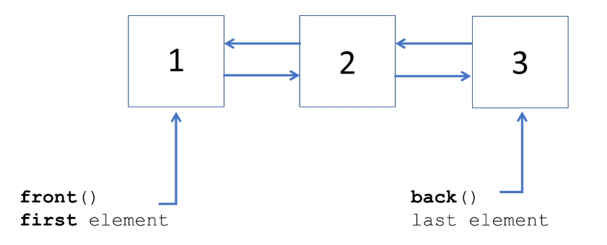
STL Container
List

Slide 60
STL Container
List methods
std::list<int> new_list {1,2,3,4,5}
new_list.front() and new_list.back()
new_list.push_back(element), new_list.push_front(element)
new_list.pop_back(), new_list.pop_fron()
Since no direct access is possible
new_list.insert(iterator, element) – inserts element to the location pointing by the iterator
new_list.erase(iterator) – delete element at location
new_list.resize(number) – resizes list to contain only number elements, all elements after number will be removed. If number is bigger than the original size of the list all new elements will be initialized with zeros
Traversing through the list can be done by incrementing iterator

Slide 61
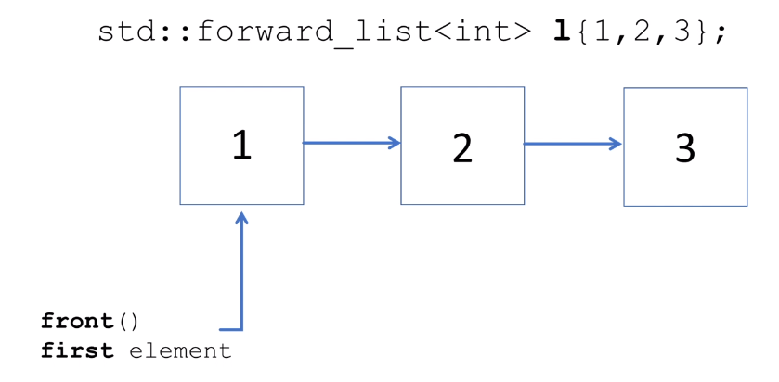
STL Container
Forward list
#include<forward_list>
Uni-directional list
Reverse iterators are not available
No .size(), no .back(), no .push_back(), no .pop_back()

Slide 62
STL Container
Sets
Associative container
Collection of stored objects that allow fast retrieval using a key
Sets and Maps
Implemented using balanced binary tree or hashsets
std::set
std::unordered_set
std::multiset
std::unordered_multiset

Slide 63
STL Container
#include<set>
Ordered by key
No duplicates
All iterators are available and are invalid when the corresponding element is deleted
std::set<int> new_set{1,2,3,4,5}
No concept of front or back
std::set<int> new_set3{1,1,2,2,3,4,4,5} // 1 2 3 4 5
new_set.size() = new_set3.size() = 5

Slide 64
STL Container
Set methods
new_set.insert(element) – inserts element to the set (set is then sorted)
Uses operator< for ordering returns std::pair<iterator, bool>, where iterator is pointing to the duplicate if it was not inserted (false) or to the new element (true)
new_set.erase(element) – delete the element from the set
new_set.erase(iterator) – deletes the element iterator is pointing to
new_set.count(element) – returns 1 or 0 depending on if element is in the set

Slide 65
STL Container
Map containers
Associative containers
std::map
std::unordered_map
std::multimap
std::unordered_multimap

Slide 66
STL Container
#include<map>
Similar to the dictionary
Elements are stored as Key Value pair (std::pair)
Ordered by key
No duplicates keys (keys are unique)
Direct element access using key
All iterators are available, invalid when the corresponding element is deleted

Slide 67
STL Container
std::map<type, type> name {{element1, element2},…}
new_map.size() – number of elements (number of pairs)
No front or back
new_map.insert(element) – adds element to the map, element must be of type std::pair<type, type> where both types are same as in the map (std::string, int)
new_map[new_key] = new_element – adds new_element to the map with the new_key as a key (types must match)
If new_key is present in the map the value is updated
new_map.erase(key) – delete the element with key from the map, works with iterators
new_map.find(key) – returns iterator to the key element

Slide 68
STL Container
Adapter container (implemented in terms of already existing containers)
Can be implemented as a vector, list or deque
std::stack
Last-in First-out (LIFO) data structure
All the operations occur on one end of the stack
No iterators are supported

Slide 69
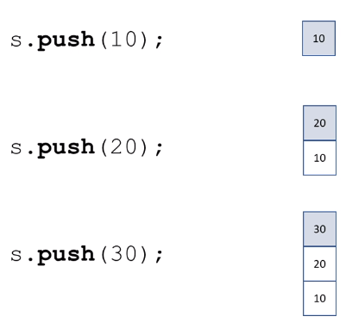
STL Container
#include<stack>
push – insert element to the top of the stack
pop – remove the element from the top of the stack
top – access the top element of the stack
empty – checks if stack is empty
size – number of the elements in the stack

Slide 70
STL Container
Since it is Adapter container the base container can be chosen
std::stack<type, container<type>> name;
std::stack<int> new_stack; – uses deque as a base container
std::stack<int, std::vector<int>> new_stack_vec; – uses vector
std::stack<int, std::list<int>> new_stack_list; – uses list

Slide 71
STL Container
Queue
std::queue
Adapter container
First-in First-out data structure
Elements are pushed in the back and popped from the front
Iterators are not supported (as a result STL algorithms are not supported)

Slide 72
STL Container
#include<queue>
The underlining container can be chosen similar to the stack
push – insert element at the back of the queue
pop – remove an element from the front of the queue
front – access the element at the front
back – access the element from the back
empty – checks if the queue is empty
size – return the size of the queue

Slide 73
STL Container
Priority queue
std::priority_queue
Adapter container
Elements are inserted in priority order (largest value is in the front)
Iterators are not supported (as a result STL algorithms are not supported)

Slide 74
STL Container
#include<queue>
std::priority_queue<type, container<type>> name
push – insert element in the sorted order
pop – removes the top of the element (biggest)
top – access the top element (do not remove)
empty – checks if the queue is empty
size – returns the size of the queue

